Slide 1





SHOE MART
A Shoe shopping Website...
PRESENTED BY: Priyanshu(1910990117) (Leader)
Aryan Bhatt(1910990104)
Japesh Gaur(1910990105)
Prateek Verma(1910990115)
GROUP: YZ2

Slide 2
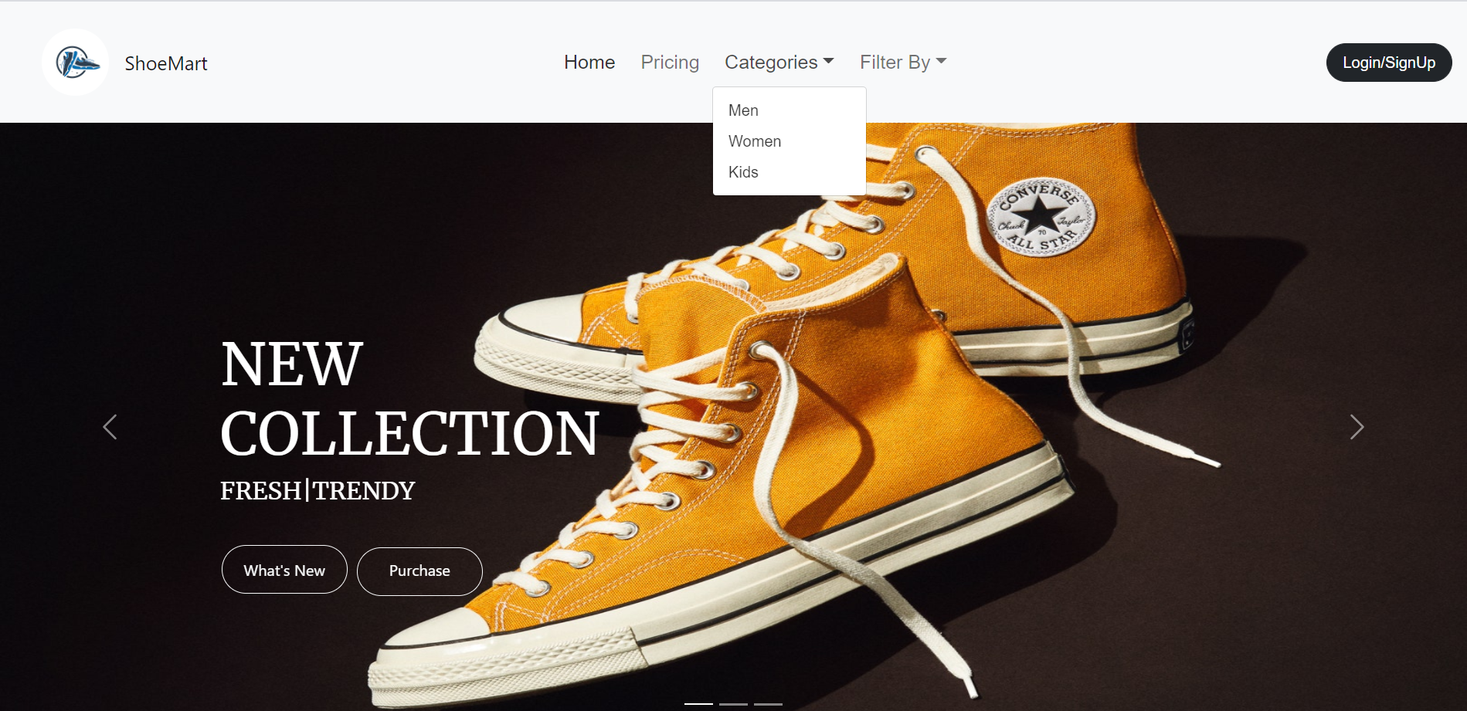


Navbar and Footer

Slide 3
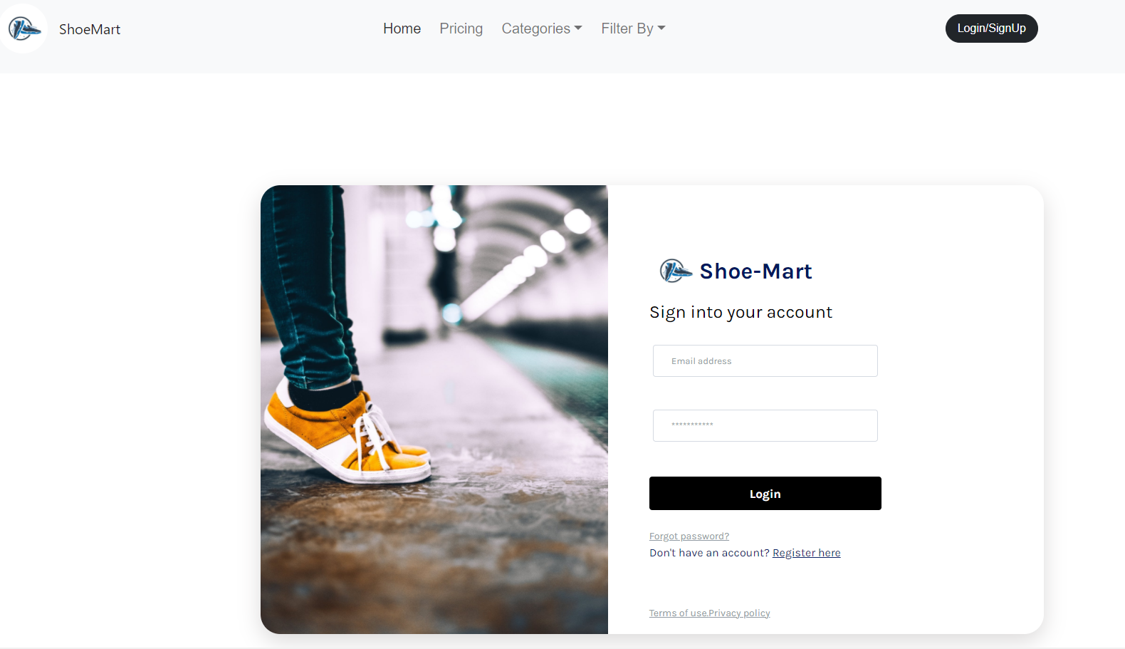
Login Page (Page Linking)

Slide 4
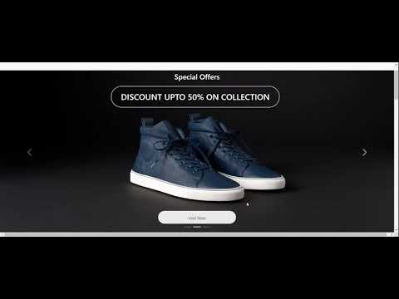
Carousel

Slide 5
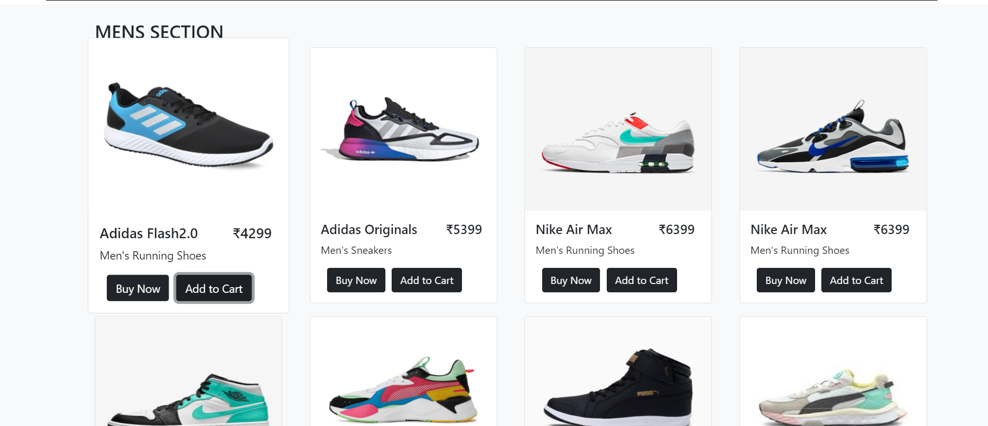
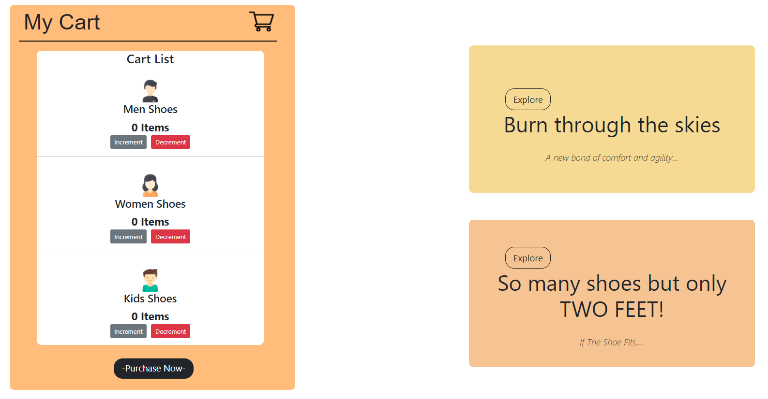
Jumbotron (Shopping Cart)

Slide 6
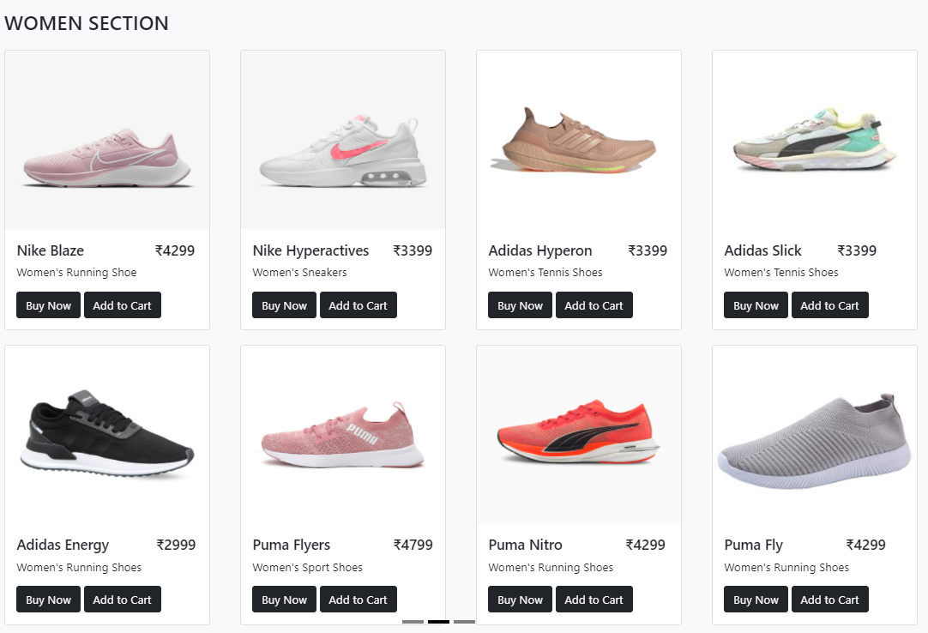
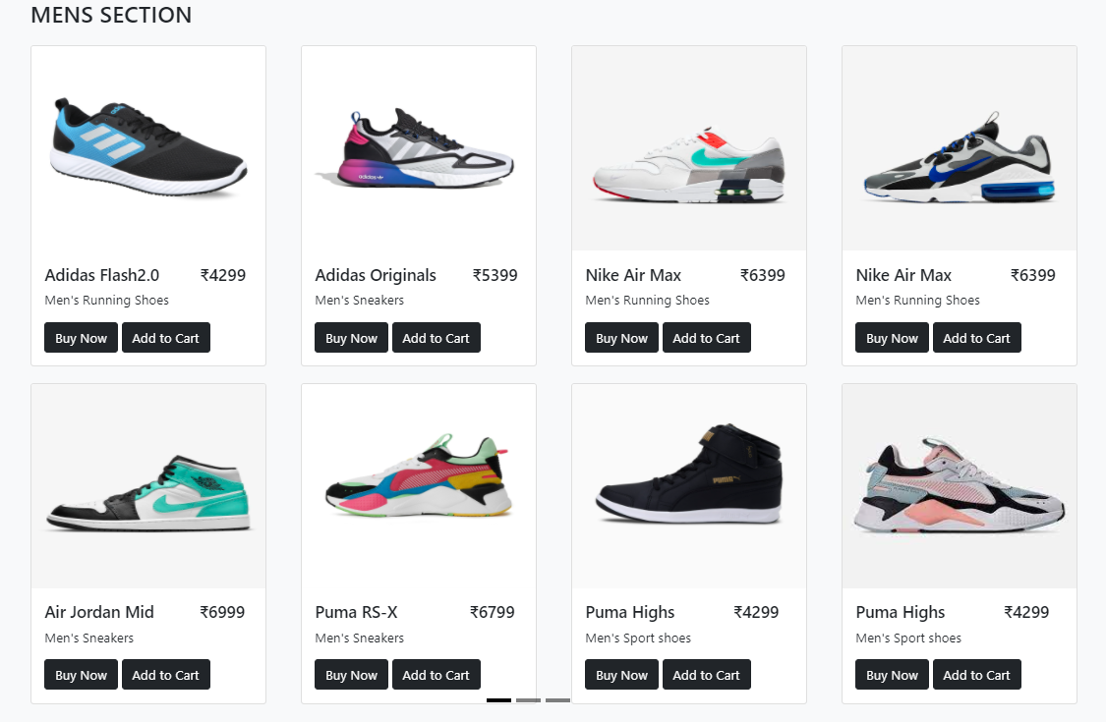
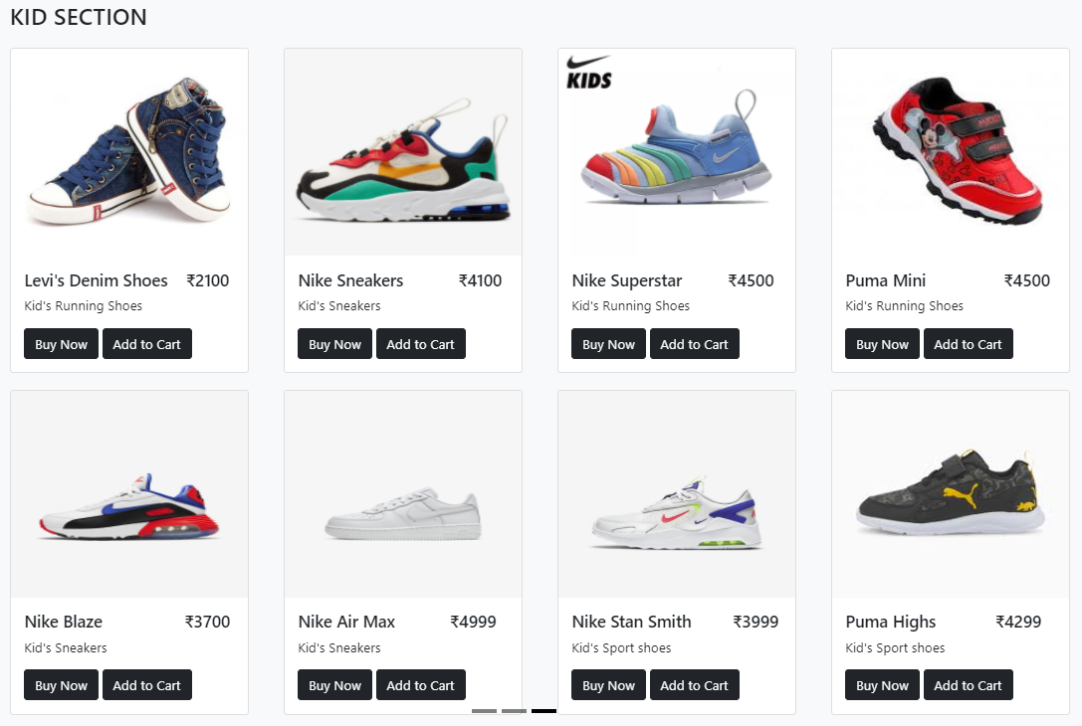
CATEGORIES
(Carousel 2 with Cards)

Slide 7
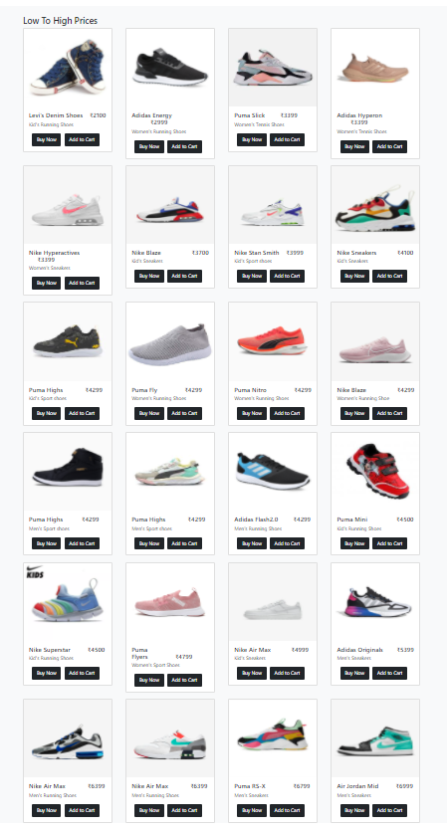
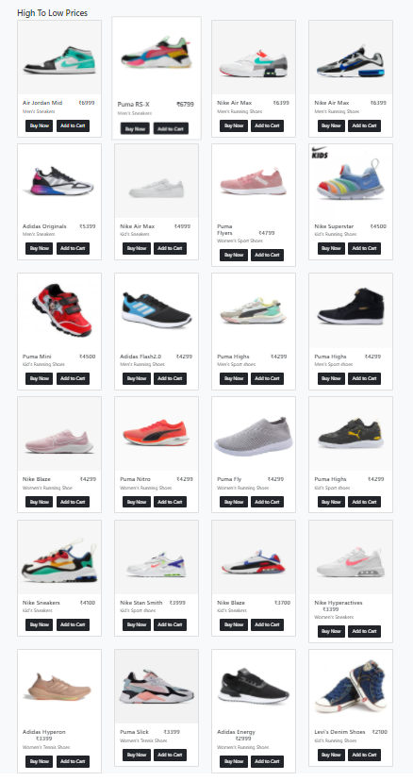
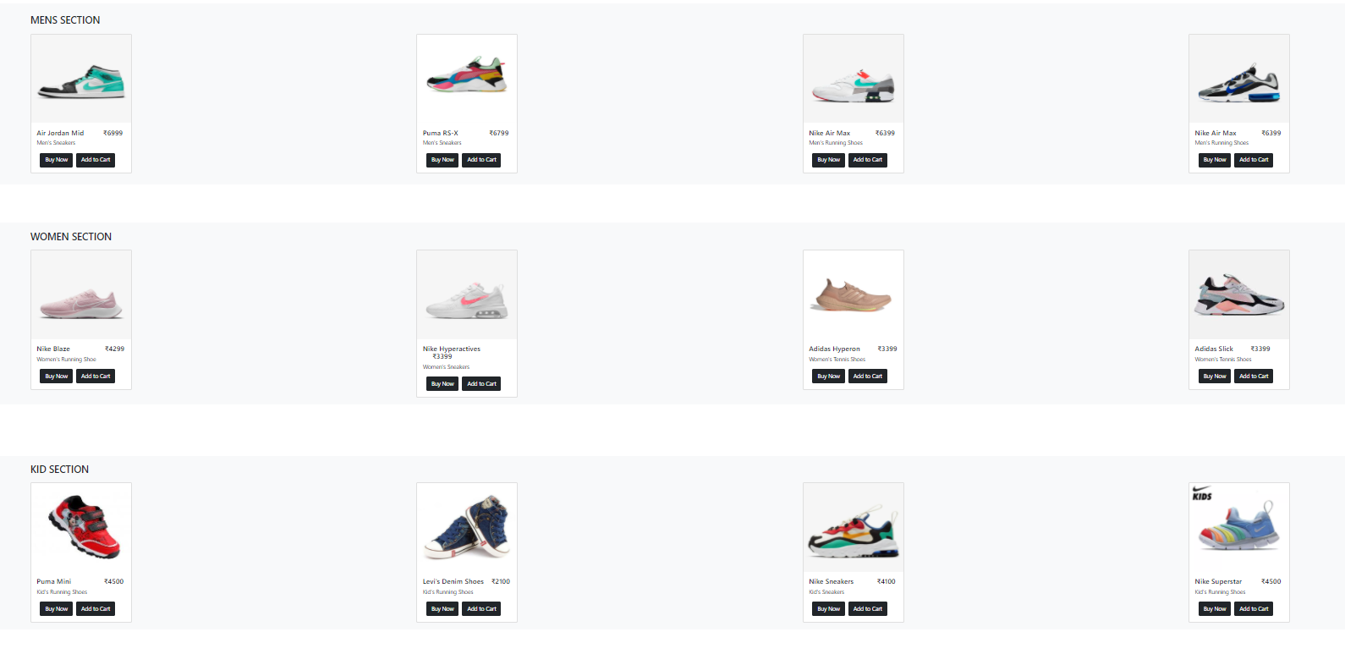
Filter/Sort By
By Popularity
Low to High
High to Low

Slide 8
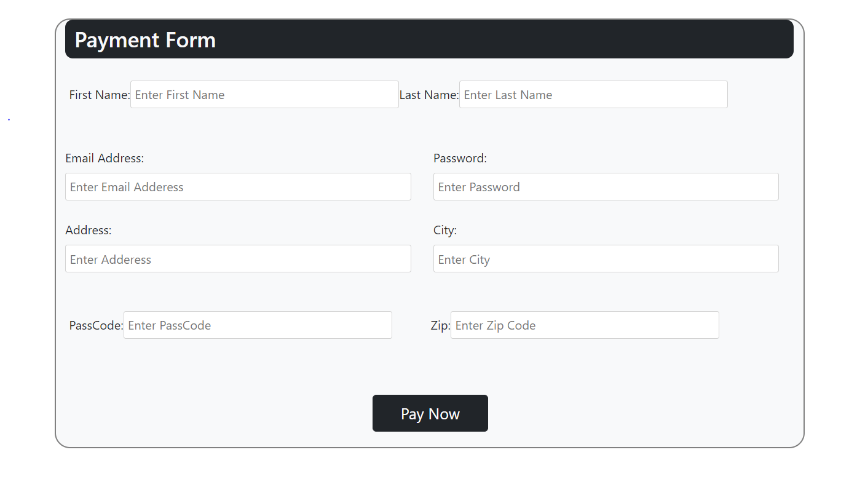
Payment Form

Slide 9
Key Features:
Shoe Mart aims at providing a hassle free and enjoyable shopping experience to shoppers across the country with the widest range of brands and products on its portal.
We offer an inbuilt cart to easily track your orders.
Our catalog is accommodates all your budget concerns.
Our user-friendly interface helps you easily navigate through our website.
Contribution:
React and Bootstrap - Aryan Bhatt & Priyanshu Bhalla
HTML, CSS and Bootstrap - Japesh Gaur & Prateek Verma

